Slide 1
Basic GIT
Nook

Slide 2
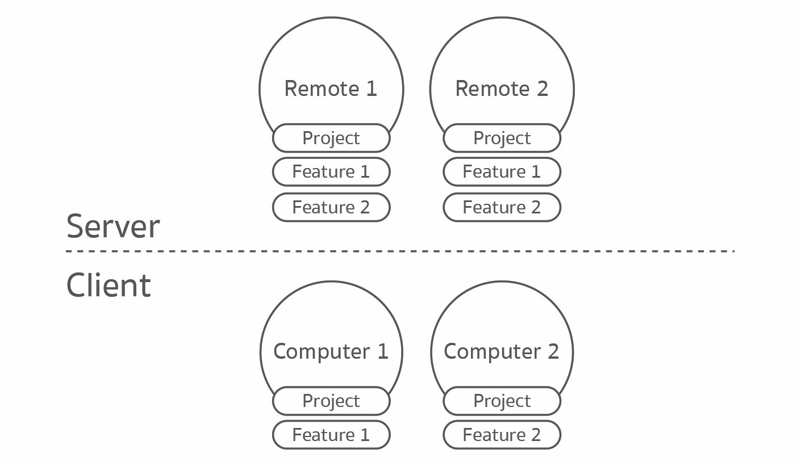
Introduction
Remote
Local

Slide 3
Start using GIT
Using Command Line
Local
Remote
git init
On first time only
git push
git commit –m”message”
git fetch
git pull
git add .
git commit –m”message”

Slide 4
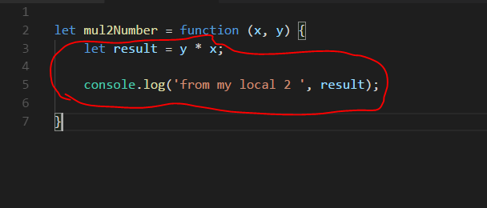
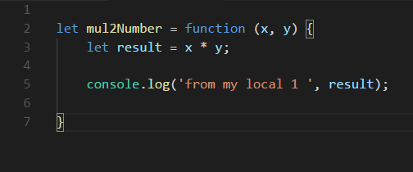
Git Conflict
Remote
simple.js
simple.js
Local A
Local B

Slide 5
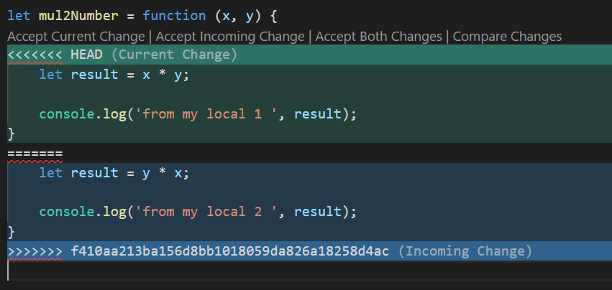
Git Conflict (cont.)
Local
Step:
Pull code from remote
fix conflict
Merge Commit
Push to remote

Slide 6
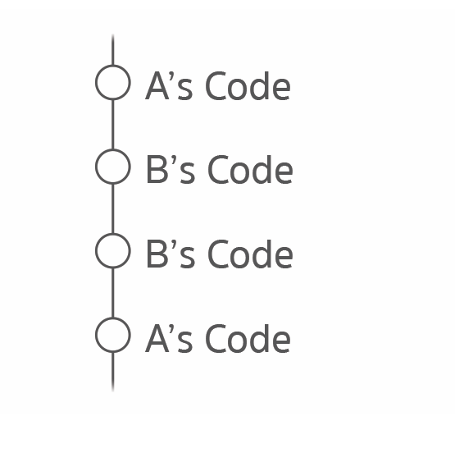
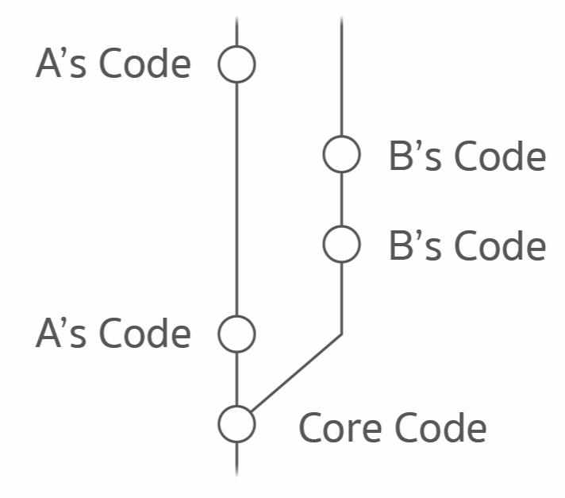
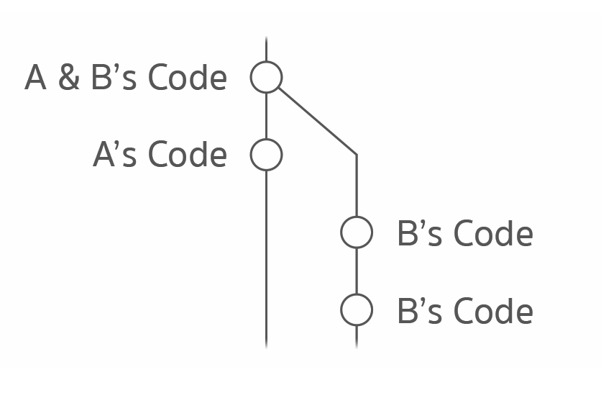
Git Branch
git branch b-name
git checkout b-name
git merge b-name

Slide 7
Homework 1
1: clone project from https://
2: create branch with your name
3: write answers in question.md
4: save and push code to your branch on remote.

Slide 8
Homework 2
1: create new project then initial git command
2: save change code
3: push to public Github by your-account
4: can share this Github project link to everyone

Slide 9
Homework 3
1: clone project from https://
2: switch to nook branch
4: create new branch name: nook-edit
5: look at refect.js and then change declare variable from var to let
6: merge nook branch with nook-edit branch
7: save and push code to nook branch on remote
8: delete nook-edit branch on remote

